Slide 1
Проект Податочно Рударство
Heart Stroke Prediction
Фјола Фетаји 181031

Slide 2
Information about the dataset
The dataset has 5112 rows and 12 columns:
id – unique id
gender – “male”, “female”, “other”
age: age of the patient
hypertension: 0 if the patient doesn't have hypertension, 1 if the patient has hypertension
heart_disease: 0 if the patient doesn't have any heart diseases, 1 if the patient has a heart disease
ever_married: "No" or "Yes"
work_type: "children", "Govt_jov", "Never_worked", "Private" or "Self-employed"
Residence_type: "Rural" or "Urban"
avg_glucose_level: average glucose level in blood
bmi: body mass index
smoking_status: "formerly smoked", "never smoked", "smokes" or "Unknown“*
stroke: 1 if the patient had a stroke or 0 if not
*Note: “Unknown” in smoking_status means that the information about this patient is unavailable

Slide 3
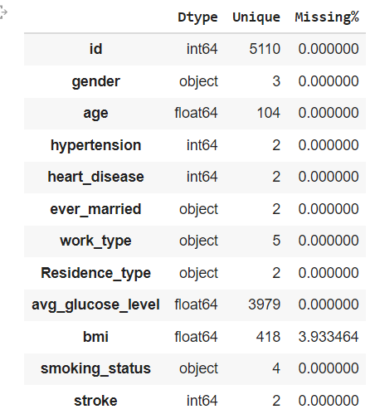
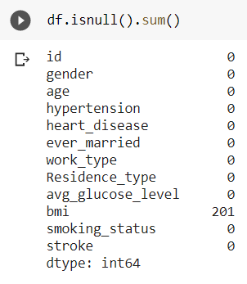
Exploratory Data Analysis
Two types of variables:
Numerical: id, age, avg_glucose_level, bmi
Categorical: gender, hypertension, heart_disease, ever_married, work_type, Residence_type, smoking_status, stroke
Dataset contains missing values. Techniques for handling missing values.

Slide 4
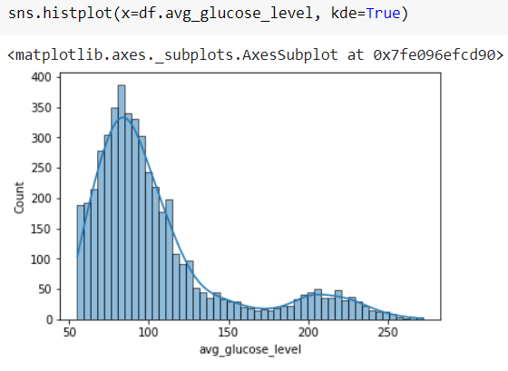
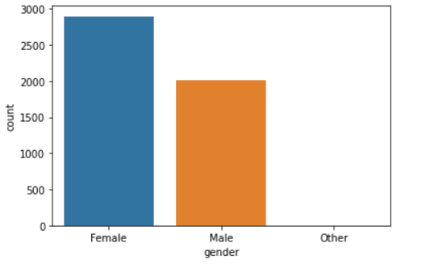
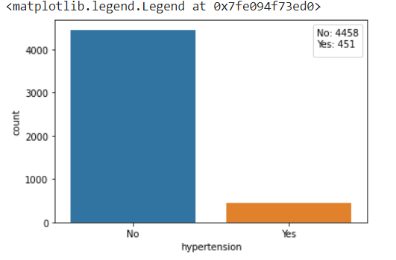
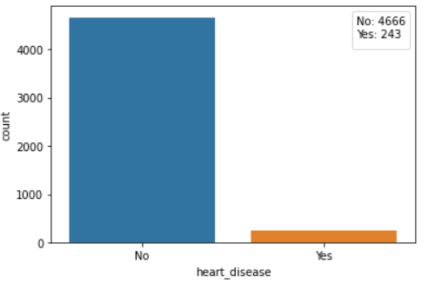
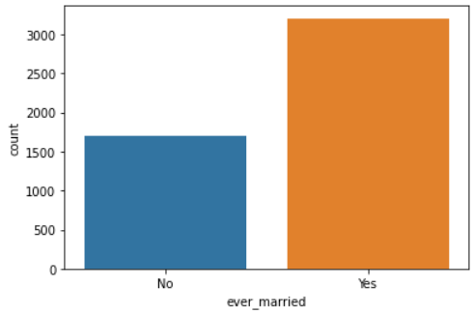

Slide 5
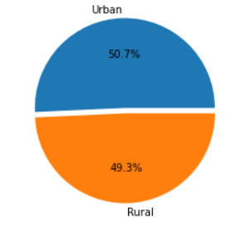
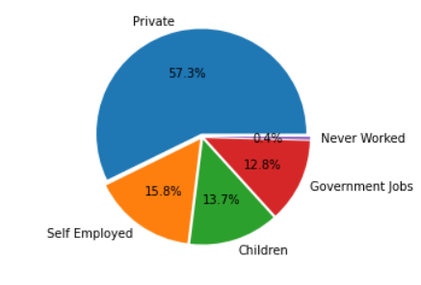
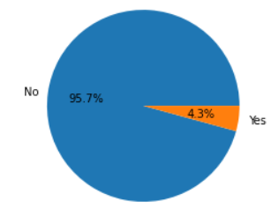

Slide 6
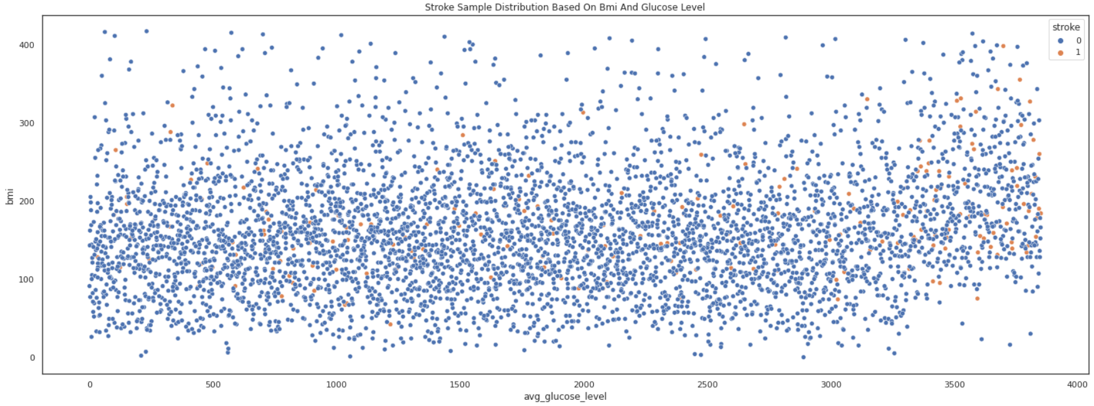
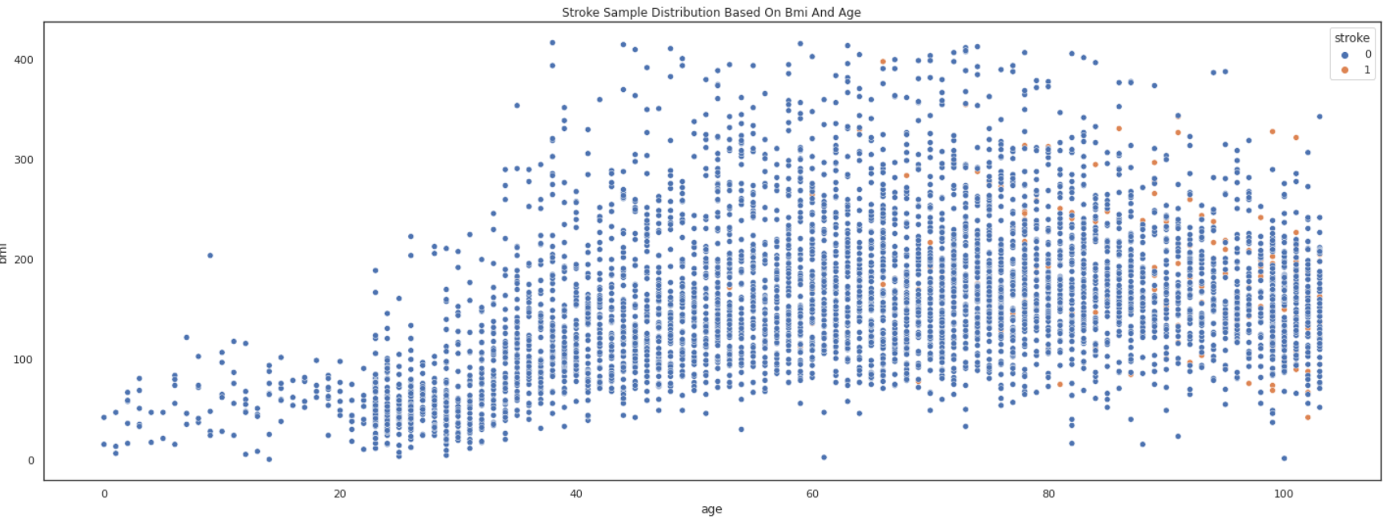
—Someone Famous

Slide 7
Conclusions of EDA
- There is a large correlation between age and stroke risk.
- Obesity (high bmi) leads to risk of stroke.
- The presence of hypertension or heart diseases also leads to stroke risk.

Slide 8
Classification
Studied techniques:
Decision Tree Classifier,
Random Forest Classifier,
Naïve Bayes Classifier,
KNN Classifier,
Logistic Regression
Additional techniques:
SVC – Support Vector Machine Classifier,
XGBClassifier,
LGBMClassifier,
Neural Network,
Deep Neural Network.

Slide 9
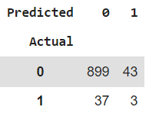
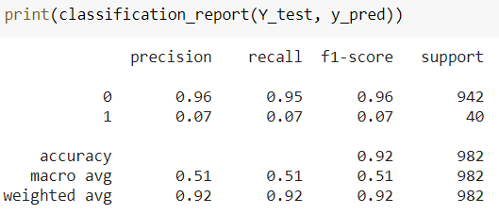
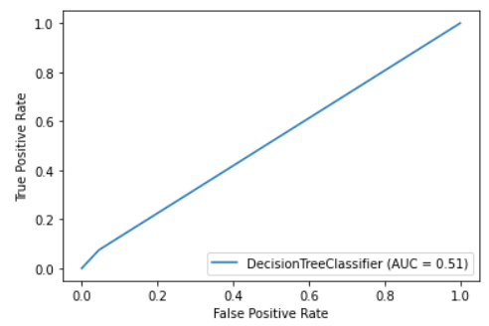
Decision Tree Classifier
Criterion=entropy
Criterion=gini
Accuracy score=0.9185
Accuracy score=0.9165

Slide 10
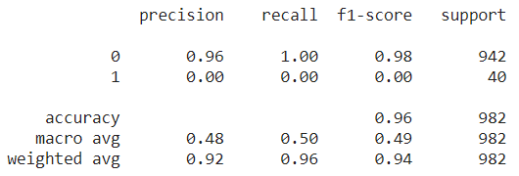
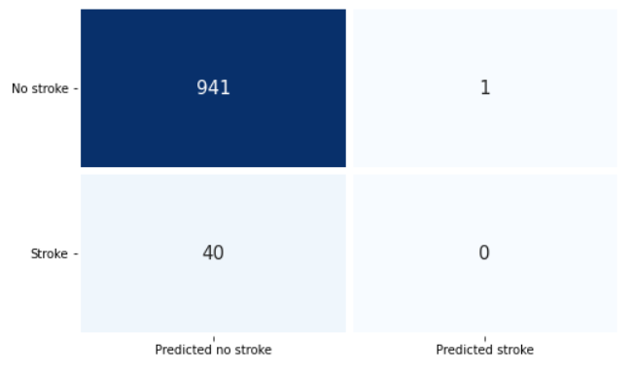
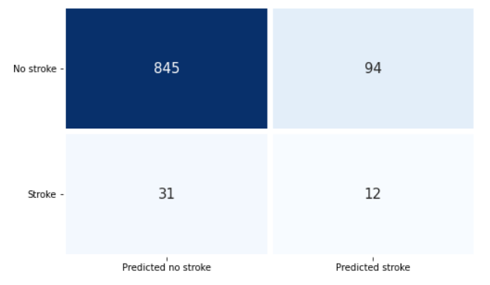
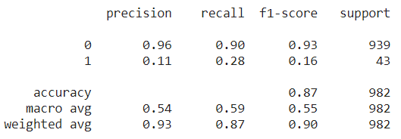
Random Forest Classifier
RandomForestClassifier(criterion='entropy', max_depth=10, random_state=0)
After SMOTE technique:

Slide 11
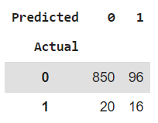
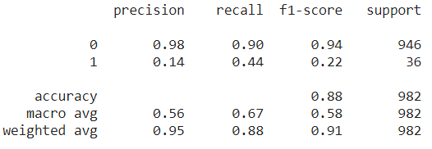
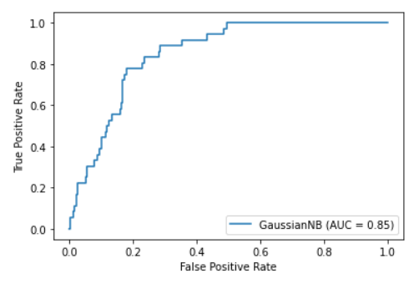
Naïve Bayes Classifier

Slide 12
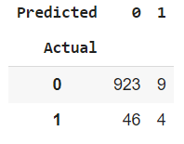
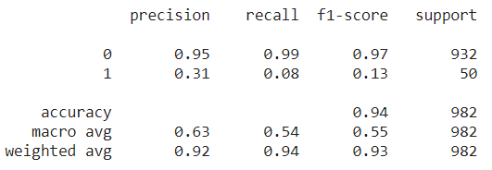
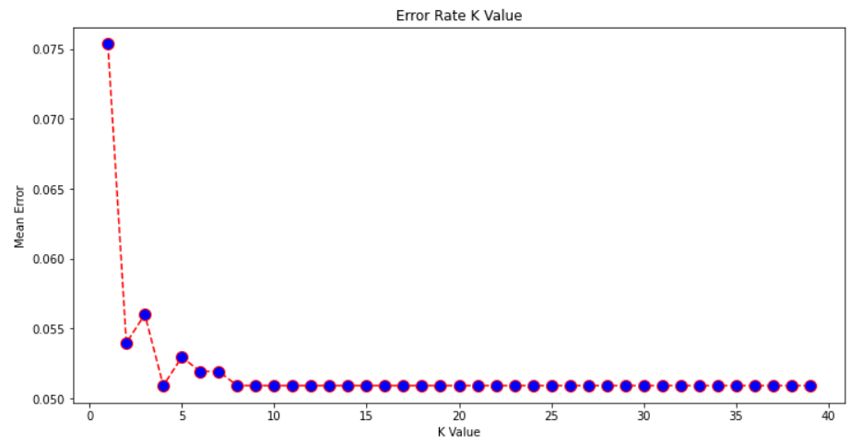
KNN Classifier
KNeighborsClassifier(n_neighbors=3)

Slide 13
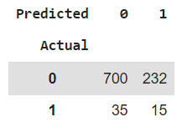
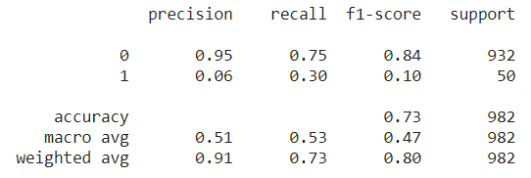
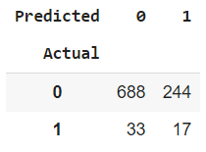
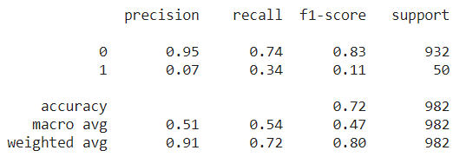
KNN Classifier
KNeighborsClassifier(n_neighbors=5)
KNeighborsClassifier(n_neighbors=10)
After using SMOTE technique

Slide 14
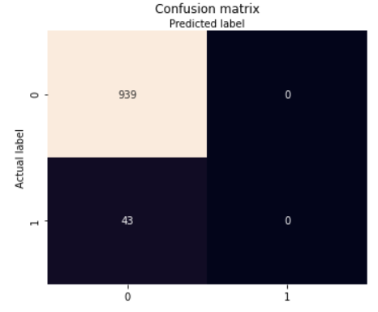
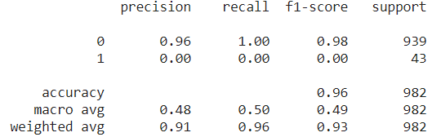
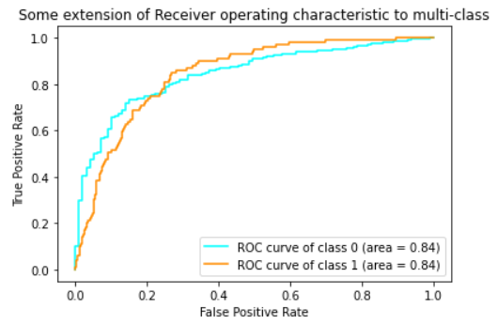
Logistic Regression
LogisticRegression(solver='liblinear', random_state=0)

Slide 15
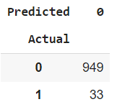
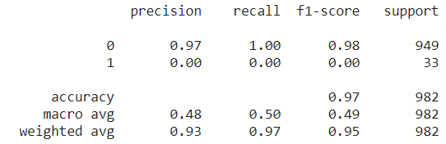
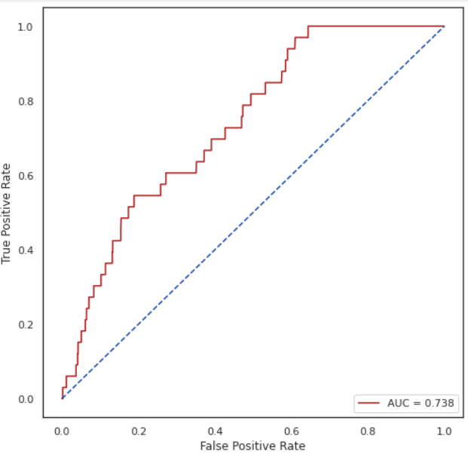
SVC – Support Vector Machine Classifier
Additional techniques
SVC(random_state = 0, probability = True, kernel='linear')

Slide 16
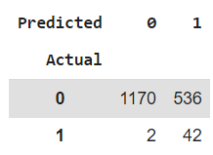
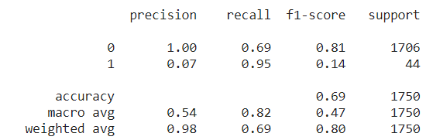
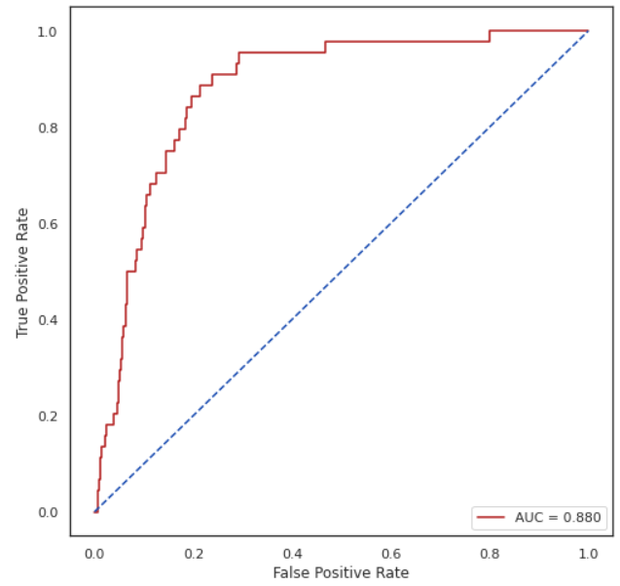
SVC – Support Vector Machine Classifier
Additional techniques
SVC(random_state = 0, probability = True, kernel='linear')
* Using the merged dataset (original + collected data by crawler)

Slide 17
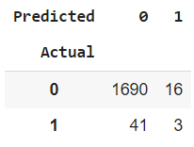
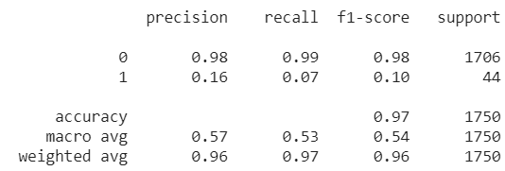
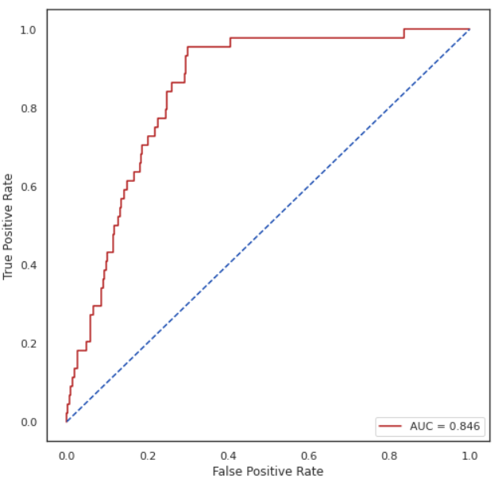
XGBClassifier
Additional techniques
XGBClassifier(random_state = 0, max_depth = 5, objective = 'binary:logistic', eval_metric = 'logloss')
* Using the merged dataset (original + collected data by crawler)

Slide 18
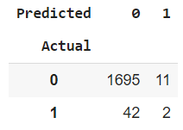
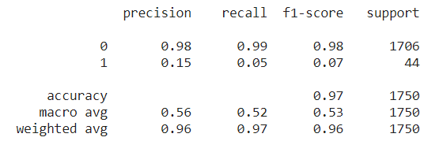
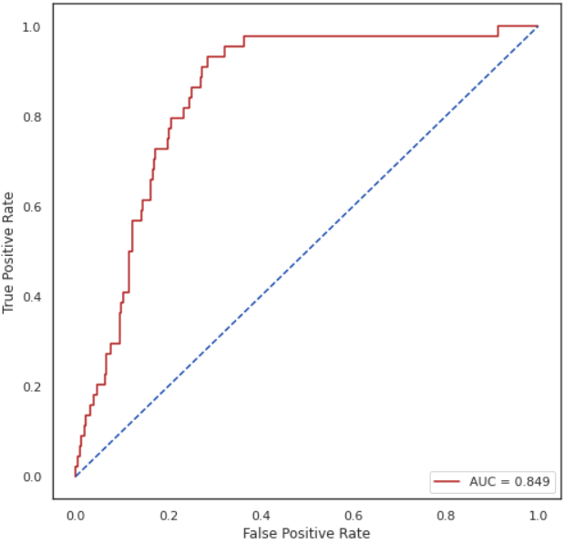
LGBMClassifier
Additional techniques
LGBMClassifier(random_state = 22, max_depth = 5, num_leaves = 50)
* Using the merged dataset (original + collected data by crawler)

Slide 19
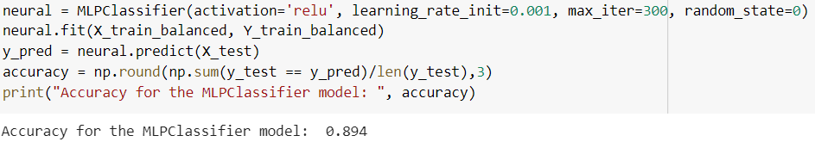
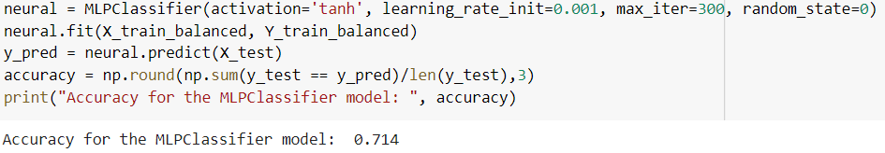
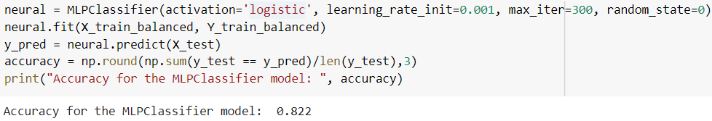
Neural Network
Additional techniques
* Using the merged dataset (original + collected data by crawler)

Slide 20
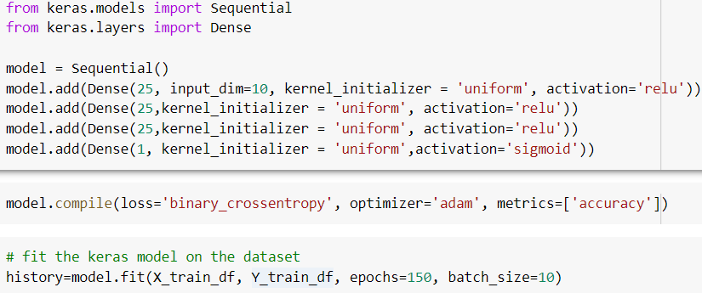
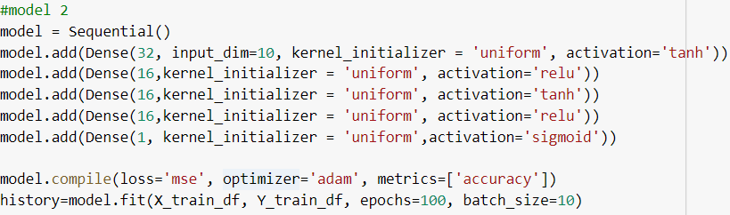
Deep Neural Network
Additional techniques
Accuracy=0.9570
ROC-AUC score=0.823
Accuracy=0.9570
ROC-AUC score=0.5

Slide 21
Regression
Studied techniques:
Linear Regression,
Lasso Regression,
Ridge Regression,
KNN Regression.
Additional techniques:
SVR,
XGBRegressor,
LGBMRegressor,
CatBoostRegressor.

Slide 22
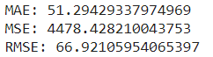
Linear Regression
Polynomial Regression
make_pipeline(PolynomialFeatures(3), LinearRegression())
Score=0.2315

Slide 23


KNN Regression
KNeighborsRegressor(n_neighbors=21)
score= 0.2473
mse=4194.2
mae=49.39

Slide 24

Lasso Regression
Ridge Regression
Lasso(alpha=0.001)
Score=0.1963
Polynomial Regression using Lasso:
make_pipeline(PolynomialFeatures(3), Lasso(alpha=1))
Score=0.2732
Ridge(alpha=0.001)
Score=0.1963
make_pipeline(PolynomialFeatures(2), Ridge(alpha=0.001))
Score=0.282

Slide 25


XGBRegressor
CatBoostRegressor
LGBMRegressor
SVR
Additional techniques
mse=7.9915
mse=7.062
LGBMRegressor(n_estimators = 1000)
mse=7.421
SVR(kernel='rbf')
mse=7.579

Slide 26
Clustering
Studied techniques:
K-Means,
Hierarchical/Agglomerative Clustering,
DBSCAN.
Additional techniques:
AffinityPropagation,
SpectralClustering,
GaussianMixtureModels.

Slide 27




K-Means

Slide 28

Hierarchical/Agglomerative Clustering
Agglomerative Clustering with complete linkage

Slide 29

Hierarchical/Agglomerative Clustering
Agglomerative Clustering with average linkage

Slide 30

Hierarchical/Agglomerative Clustering
Agglomerative Clustering with single linkage

Slide 31

DBSCAN
DBSCAN(eps=8, min_samples=4)

Slide 32


Affinity Propagation
Spectral Clustering
Additional Techniques
SpectralClustering(n_clusters=2, random_state=1, affinity='nearest_neighbors')

Slide 33

Gaussian Mixture Model
Additional Techniques

Slide 34

Comparing different clustering algorithms

Slide 35



Enriching the dataset using Selenium crawlers
Using Selenium crawlers I fetch data from a github repository that contains data about heart patients

Slide 36


Enriching the dataset using Selenium crawlers

Slide 37

Enriching the dataset using Selenium crawlers

Slide 38
Implementation of approaches from scientific papers
An intregrated machine learning approach to stroke prediction
Comparing deep neural network and other machine learning algorithms for stroke prediction in a large-scale population-based electronic medical claims database
Stroke prediction using SVM
Stroke Prediction with Machine Learning methods among Older Chinese
Prediction of Heart Disease Using Machine Learning

Slide 39
THANKS!

